Slide 1
Project Title: Provision of Semi-automatic Radiator Coolant Water Topping System for Agbd2 EP’s
Charter Template
Business Case/objectives:
Agbada 2 FS has 7 Export Pumps and the Radiators on these Pumps are being topped with coolant water manually. This activity poses a HSSE threat (such as Burn from Steam, fatigue from multiple rounds, trip and fall, increased stress, etc.) to personnel executing it, as the topping of the Radiator Coolant Water was not originally design to be done manually.
This proposal aims to eliminate the above HHSE Threats, thereby reducing unsafe conditions related to coolant water topping activity.
Potential Benefits:
Reduction of Unsafe Conditions.
Improve Productive Work Time.
Reduced stress on Personnel.
Reduction of Equipment Over-heating related failures.
Project Scope/Actions :
Develop possible Coolant Water Supply Flow schemes.
Develop Cost estimate for different Flow Schemes.
Share cost for different Flow Schemes with Team.
Raise a notification and generate WO for activity execution.
Engage C&P for procurement of items.
Receive items and assemble/construct at Site.
Commission & hand-over to Operations.
Develop SOP, if required.
Critical Success Factors:
Support from Leadership
Budget Availability
High-level Timeline:
L0-L1: Seek approval for project initiation - 9th October, 2018
L2: Develop project scope & cost - 25th October, 2018
L3: Scope approval - 28th November, 2018
L4: Implement approved scope - 14th December, 2018
L5: Monitor and track improvement in SGF and RF 20th Jan, 2019
Initiative End : 5th February, 2019
Project Sponsor: Oamen Christopher/Babatunde Alepaye
Implementation Lead: Washington Uwowa.
Project Team: Olumide Adeyeri, Onyenumoh E., Lambert O., Adewale Oladipupo & Akpan Nkereuwem.

Slide 2
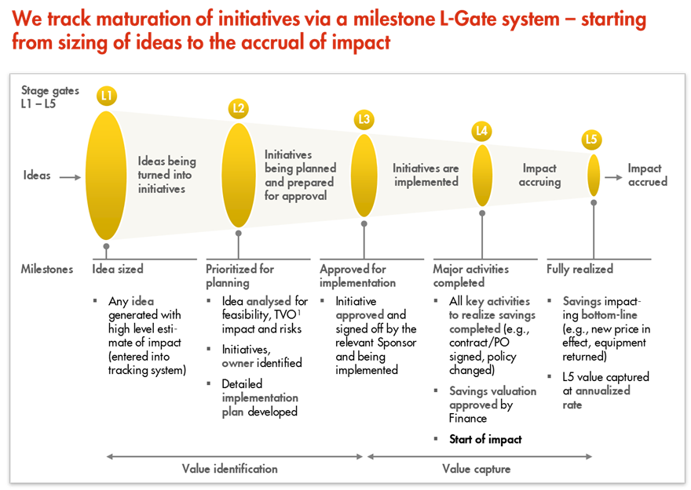
L1 – L5 Gates

